Slide 1

Collaborating using Git
R Ladies Git Workshop: 4/14/2023

Slide 2
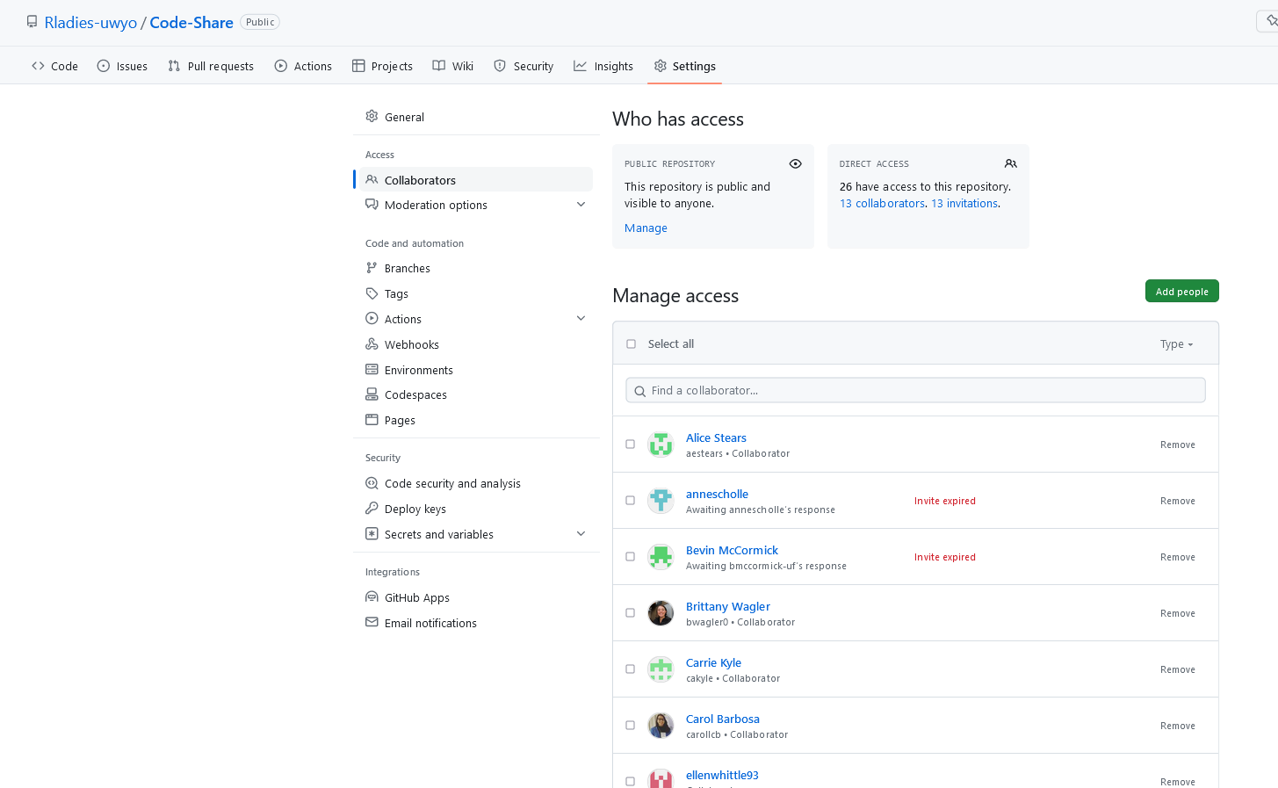
Adding collaborators to your repositories

Slide 3
Working with someone else’s repository
You can fork their repository (allows you to make changes on a copy of the repository without affecting original project)
You can clone the repository (if you have collaborator access from owner, allows you to make changes to original project)

Slide 4
Forking someone else’s repository
Changes you make will only be saved to a new repository in YOUR account, will not affect owner’s
If you’d like to submit your changes to the owner, submit a pull request

Slide 5
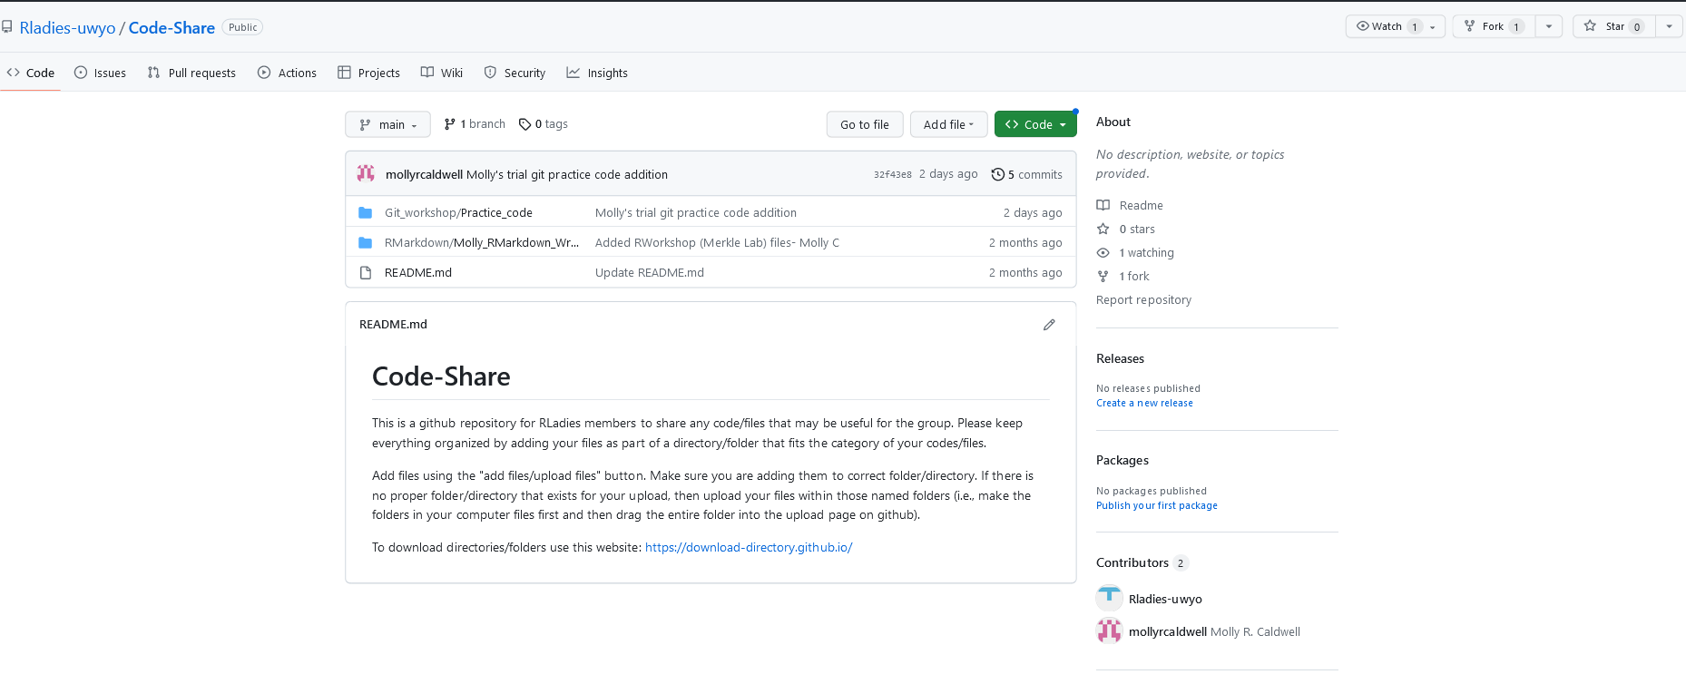
Forking someone else’s repository

Slide 6
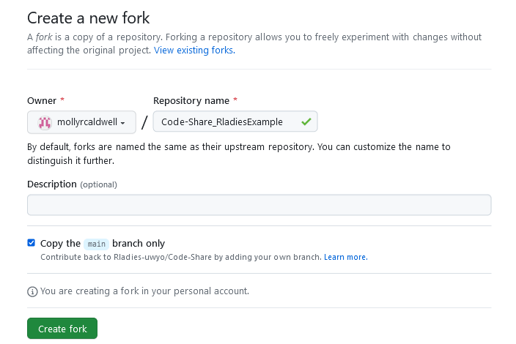
Forking someone else’s repository

Slide 7
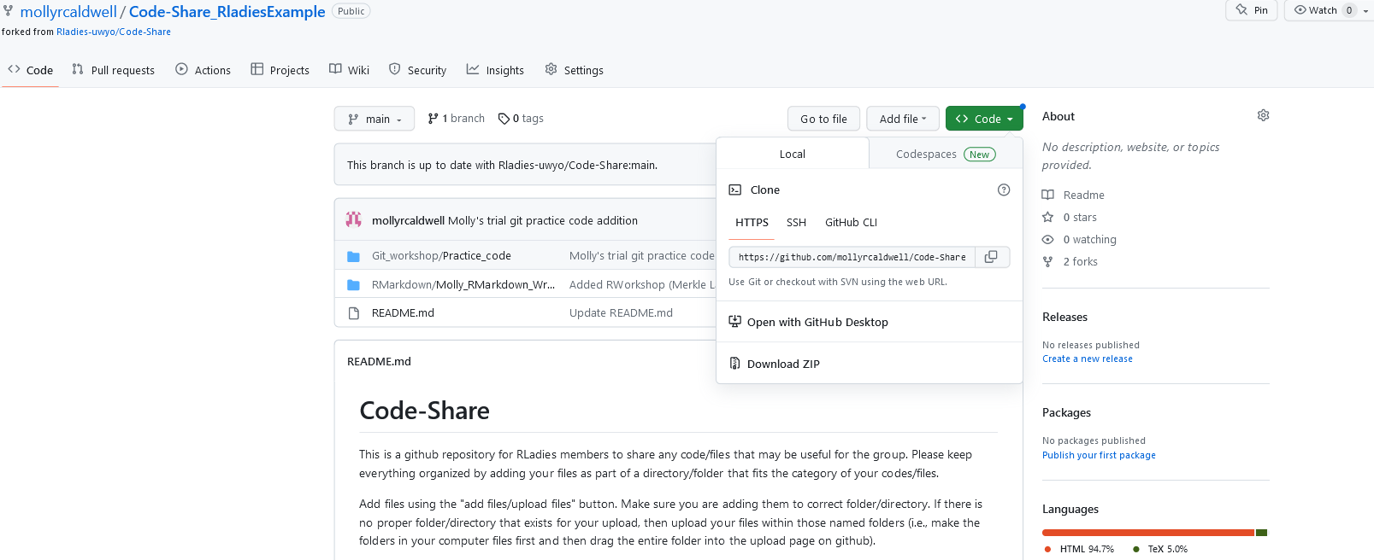
Forking someone else’s repository

Slide 8
Forking someone else’s repository

Slide 9
Forking someone else’s repository
Clone to Rstudio
Make changes to Git workshop example code
Commit and Push changes as usual (to your github account)

Slide 10
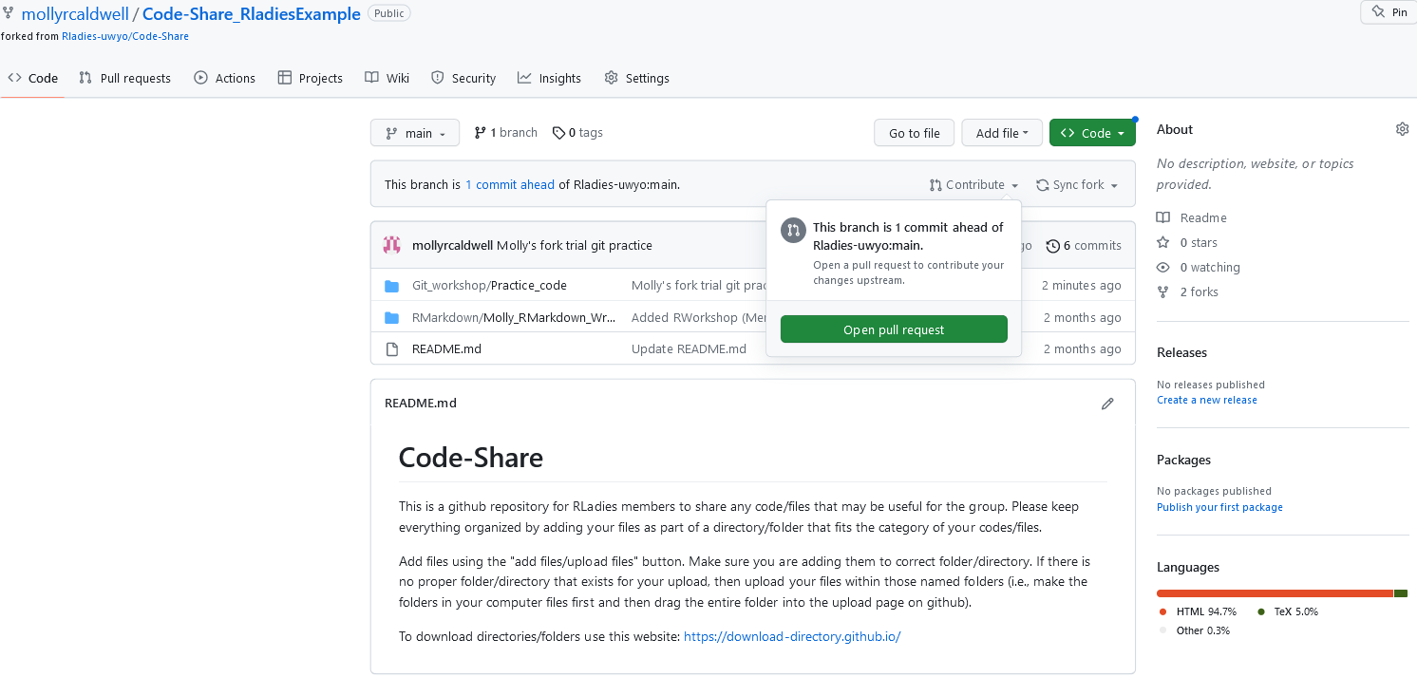
Forking someone else’s repository

Slide 11
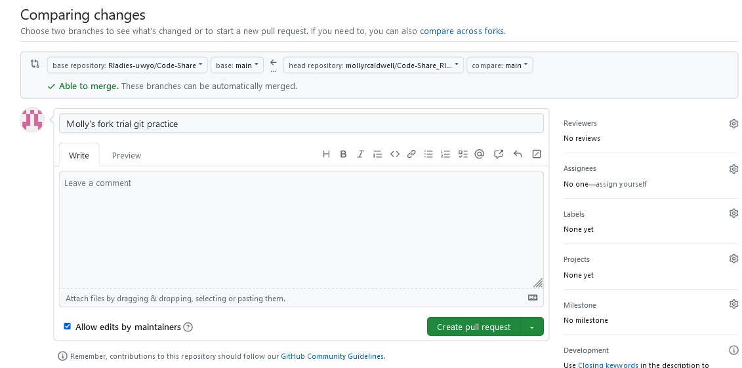
Forking someone else’s repository

Slide 12
Forking someone else’s repository
Owner of repository can review your pull request, and merge it to their original repository
If you are an approved collaborator, you have the ability to merge your own pull request to the owner’s original repository

Slide 13
Cloning someone else’s repository
Make changes directly to owner’s repository (best practice to push changes to your own branch, rather than main)
Have to have collaborator access to that repository

Slide 14
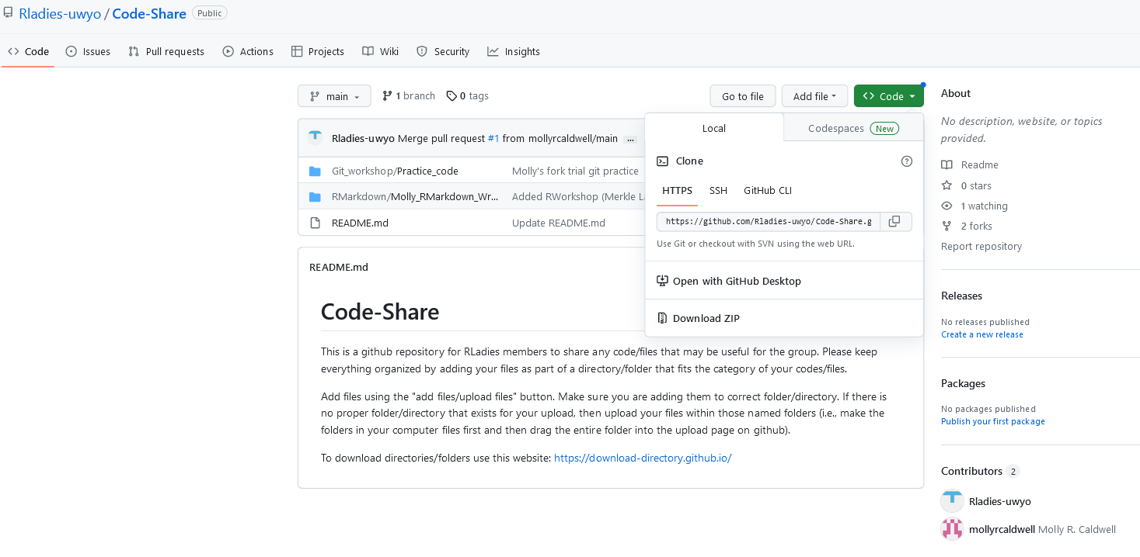
Cloning someone else’s repository

Slide 15
Cloning someone else’s repository
Once you clone repository in Rstudio,
Pull
Make changes
Commit
And Push as normal
[If you do not have collaborator access from owner of repository, you will see an error message when trying to push commit]

